Slide 1
SOA Exam FM
Module 2 – Section 5
Unknown Interest Rates Examples

Slide 2


$$Unknown Interest Rates$$
Example 1: A 10-year annuity immediate with annual payments has an initial payment of $11$. Each subsequent payment is 10% more than its preceding payment. The accumulated value of the annuity is 220.8 using an annual effective interest rate, $i$. Determine $i$.

Slide 3





$$Unknown Interest Rates$$
Example 1: A 10-year annuity immediate with annual payments has an initial payment of $11$. Each subsequent payment is 10% more than its preceding payment. The accumulated value of the annuity is 220.8 using an annual effective interest rate, $i$. Determine $i$.
$$11$$
$$11(1.1)$$
$$⋯$$
$${11(1.1)}^{9}$$
$$⋯$$
$$years$$
$$AV=220.8$$

Slide 4







$$Unknown Interest Rates$$
$$i=aeir$$
$$11$$
$$11(1.1)$$
$$⋯$$
$${11(1.1)}^{9}$$
$$⋯$$
$$years$$
$$AV=220.8$$

Slide 5
$$Unknown Interest Rates$$
$$i=aeir$$
$$11$$
$$11(1.1)$$
$$⋯$$
$${11(1.1)}^{9}$$
$$⋯$$
$$years$$
$$AV=220.8$$
Step 1: VEP at the Valuation Date

Slide 6
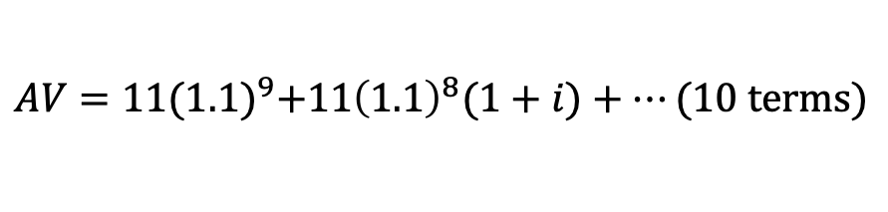
$$Unknown Interest Rates$$
$$i=aeir$$
$$11$$
$$11(1.1)$$
$$⋯$$
$${11(1.1)}^{9}$$
$$⋯$$
$$years$$
$$AV=220.8$$
Step 1: VEP at the Valuation Date
$$AV=11{(1.1)}^{9}+11{\left(1.1\right)}^{8}(1+i)+⋯(10 terms)$$

Slide 7
$$Unknown Interest Rates$$
$$i=aeir$$
$$11$$
$$11(1.1)$$
$$⋯$$
$${11(1.1)}^{9}$$
$$⋯$$
$$years$$
$$AV=220.8$$
Step 1: VEP at the Valuation Date
$$AV=11{(1.1)}^{9}+11{\left(1.1\right)}^{8}(1+i)+⋯(10 terms)$$
Step 2: Factor out the First Term

Slide 8

$$Unknown Interest Rates$$
$$i=aeir$$
$$11$$
$$11(1.1)$$
$$⋯$$
$${11(1.1)}^{9}$$
$$⋯$$
$$years$$
$$AV=220.8$$
Step 1: VEP at the Valuation Date
$$AV=11{(1.1)}^{9}+11{\left(1.1\right)}^{8}(1+i)+⋯(10 terms)$$
Step 2: Factor out the First Term
$$220.8=11{(1.1)}^{9}∙\left(1+\frac{1+i}{1.1}+⋯(10 terms)\right)$$

Slide 9

$$Unknown Interest Rates$$
$$i=aeir$$
$$11$$
$$11(1.1)$$
$$⋯$$
$${11(1.1)}^{9}$$
$$⋯$$
$$years$$
$$AV=220.8$$
Step 1: VEP at the Valuation Date
$$AV=11{(1.1)}^{9}+11{\left(1.1\right)}^{8}(1+i)+⋯(10 terms)$$
Step 2: Factor out the First Term
$$220.8=11{(1.1)}^{9}∙\left(1+\frac{1+i}{1.1}+⋯(10 terms)\right)$$

Slide 10
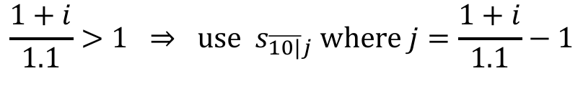
$$Unknown Interest Rates$$
$$i=aeir$$
$$11$$
$$11(1.1)$$
$$⋯$$
$${11(1.1)}^{9}$$
$$⋯$$
$$years$$
$$AV=220.8$$
Step 1: VEP at the Valuation Date
$$AV=11{(1.1)}^{9}+11{\left(1.1\right)}^{8}(1+i)+⋯(10 terms)$$
Step 2: Factor out the First Term
$$220.8=11{(1.1)}^{9}∙\left(1+\frac{1+i}{1.1}+⋯(10 terms)\right)$$
$$\frac{1+i}{1.1}>1 ⇒ use s_{\overline{10|}j} where j=\frac{1+i}{1.1}−1$$

Slide 11
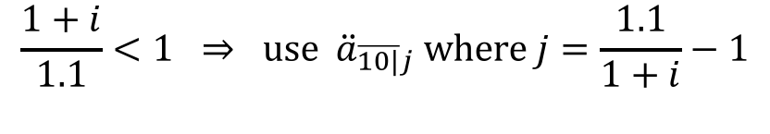
$$Unknown Interest Rates$$
$$i=aeir$$
$$11$$
$$11(1.1)$$
$$⋯$$
$${11(1.1)}^{9}$$
$$⋯$$
$$years$$
$$AV=220.8$$
Step 1: VEP at the Valuation Date
$$AV=11{(1.1)}^{9}+11{\left(1.1\right)}^{8}(1+i)+⋯(10 terms)$$
Step 2: Factor out the First Term
$$220.8=11{(1.1)}^{9}∙\left(1+\frac{1+i}{1.1}+⋯(10 terms)\right)$$
$$\frac{1+i}{1.1}>1 ⇒ use s_{\overline{10|}j} where j=\frac{1+i}{1.1}−1$$
$$\frac{1+i}{1.1}<1 ⇒ use {\ddot{a}}_{\overline{10|}j} where j=\frac{1.1}{1+i}−1$$

Slide 12
$$Unknown Interest Rates$$
$$i=aeir$$
$$11$$
$$11(1.1)$$
$$⋯$$
$${11(1.1)}^{9}$$
$$⋯$$
$$years$$
$$AV=220.8$$
Step 1: VEP at the Valuation Date
$$AV=11{(1.1)}^{9}+11{\left(1.1\right)}^{8}(1+i)+⋯(10 terms)$$
Step 2: Factor out the First Term
$$220.8=11{(1.1)}^{9}∙\left(1+\frac{1+i}{1.1}+⋯(10 terms)\right)$$

Slide 13
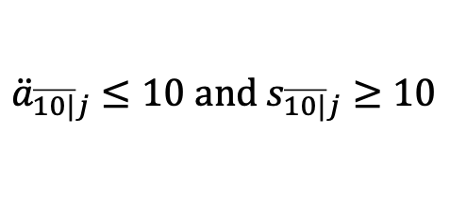
$$Unknown Interest Rates$$
$$i=aeir$$
$$11$$
$$11(1.1)$$
$$⋯$$
$${11(1.1)}^{9}$$
$$⋯$$
$$years$$
$$AV=220.8$$
Step 1: VEP at the Valuation Date
$$AV=11{(1.1)}^{9}+11{\left(1.1\right)}^{8}(1+i)+⋯(10 terms)$$
Step 2: Factor out the First Term
$$220.8=11{(1.1)}^{9}∙\left(1+\frac{1+i}{1.1}+⋯(10 terms)\right)$$
$${\ddot{a}}_{\overline{10|}j}≤10 and s_{\overline{10|}j}≥10$$

Slide 14

$$Unknown Interest Rates$$
$$i=aeir$$
$$11$$
$$11(1.1)$$
$$⋯$$
$${11(1.1)}^{9}$$
$$⋯$$
$$years$$
$$AV=220.8$$
Step 1: VEP at the Valuation Date
$$AV=11{(1.1)}^{9}+11{\left(1.1\right)}^{8}(1+i)+⋯(10 terms)$$
Step 2: Factor out the First Term
$$220.8=11{(1.1)}^{9}∙\left(1+\frac{1+i}{1.1}+⋯(10 terms)\right)$$
$${\ddot{a}}_{\overline{10|}j}≤10 and s_{\overline{10|}j}≥10$$

Slide 15
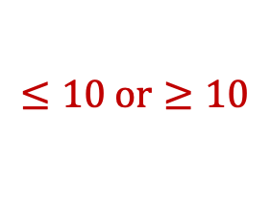
$$Unknown Interest Rates$$
$$i=aeir$$
$$11$$
$$11(1.1)$$
$$⋯$$
$${11(1.1)}^{9}$$
$$⋯$$
$$years$$
$$AV=220.8$$
Step 1: VEP at the Valuation Date
$$AV=11{(1.1)}^{9}+11{\left(1.1\right)}^{8}(1+i)+⋯(10 terms)$$
Step 2: Factor out the First Term
$$220.8=11{(1.1)}^{9}∙\left(1+\frac{1+i}{1.1}+⋯(10 terms)\right)$$
$$≤10 or≥10$$
$${\ddot{a}}_{\overline{10|}j}≤10 and s_{\overline{10|}j}≥10$$

Slide 16

$$Unknown Interest Rates$$
$$i=aeir$$
$$11$$
$$11(1.1)$$
$$⋯$$
$${11(1.1)}^{9}$$
$$⋯$$
$$years$$
$$AV=220.8$$
Step 1: VEP at the Valuation Date
$$AV=11{(1.1)}^{9}+11{\left(1.1\right)}^{8}(1+i)+⋯(10 terms)$$
Step 2: Factor out the First Term
$$220.8=11{(1.1)}^{9}∙\left(1+\frac{1+i}{1.1}+⋯(10 terms)\right)$$
$$≤10 or≥10$$
$${\ddot{a}}_{\overline{10|}j}≤10 and s_{\overline{10|}j}≥10$$

Slide 17
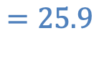
$$Unknown Interest Rates$$
$$i=aeir$$
$$11$$
$$11(1.1)$$
$$⋯$$
$${11(1.1)}^{9}$$
$$⋯$$
$$years$$
$$AV=220.8$$
Step 1: VEP at the Valuation Date
$$AV=11{(1.1)}^{9}+11{\left(1.1\right)}^{8}(1+i)+⋯(10 terms)$$
Step 2: Factor out the First Term
$$220.8=11{(1.1)}^{9}∙\left(1+\frac{1+i}{1.1}+⋯(10 terms)\right)$$
$$=25.9$$
$$≤10 or≥10$$
$${\ddot{a}}_{\overline{10|}j}≤10 and s_{\overline{10|}j}≥10$$

Slide 18
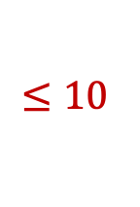
$$Unknown Interest Rates$$
$$i=aeir$$
$$11$$
$$11(1.1)$$
$$⋯$$
$${11(1.1)}^{9}$$
$$⋯$$
$$years$$
$$AV=220.8$$
Step 1: VEP at the Valuation Date
$$AV=11{(1.1)}^{9}+11{\left(1.1\right)}^{8}(1+i)+⋯(10 terms)$$
Step 2: Factor out the First Term
$$220.8=11{(1.1)}^{9}∙\left(1+\frac{1+i}{1.1}+⋯(10 terms)\right)$$
$$≤10$$

Slide 19
$$Unknown Interest Rates$$
$$i=aeir$$
$$11$$
$$11(1.1)$$
$$⋯$$
$${11(1.1)}^{9}$$
$$⋯$$
$$years$$
$$AV=220.8$$
Step 1: VEP at the Valuation Date
$$AV=11{(1.1)}^{9}+11{\left(1.1\right)}^{8}(1+i)+⋯(10 terms)$$
Step 2: Factor out the First Term
$$220.8=11{(1.1)}^{9}∙\left(1+\frac{1+i}{1.1}+⋯(10 terms)\right)$$
Step 3: Recognize the Remaining Factor

Slide 20

$$Unknown Interest Rates$$
$$i=aeir$$
$$11$$
$$11(1.1)$$
$$⋯$$
$${11(1.1)}^{9}$$
$$⋯$$
$$years$$
$$AV=220.8$$
Step 1: VEP at the Valuation Date
$$AV=11{(1.1)}^{9}+11{\left(1.1\right)}^{8}(1+i)+⋯(10 terms)$$
Step 2: Factor out the First Term
$$220.8=11{(1.1)}^{9}∙\left(1+\frac{1+i}{1.1}+⋯(10 terms)\right)$$
Step 3: Recognize the Remaining Factor
$$220.8=11{(1.1)}^{9}∙{\ddot{a}}_{\overline{10|}j}$$

Slide 21

$$Unknown Interest Rates$$
$$i=aeir$$
$$11$$
$$11(1.1)$$
$$⋯$$
$${11(1.1)}^{9}$$
$$⋯$$
$$years$$
$$AV=220.8$$
Step 1: VEP at the Valuation Date
$$AV=11{(1.1)}^{9}+11{\left(1.1\right)}^{8}(1+i)+⋯(10 terms)$$
Step 2: Factor out the First Term
$$220.8=11{(1.1)}^{9}∙\left(1+\frac{1+i}{1.1}+⋯(10 terms)\right)$$
Step 3: Recognize the Remaining Factor
$$220.8=11{(1.1)}^{9}∙{\ddot{a}}_{\overline{10|}j}$$
$$⇒j=0.03773⋯$$

Slide 22

$$Unknown Interest Rates$$
$$i=aeir$$
$$11$$
$$11(1.1)$$
$$⋯$$
$${11(1.1)}^{9}$$
$$⋯$$
$$years$$
$$AV=220.8$$
Step 1: VEP at the Valuation Date
$$AV=11{(1.1)}^{9}+11{\left(1.1\right)}^{8}(1+i)+⋯(10 terms)$$
Step 2: Factor out the First Term
$$220.8=11{(1.1)}^{9}∙\left(1+\frac{1+i}{1.1}+⋯(10 terms)\right)$$
Step 3: Recognize the Remaining Factor
$$220.8=11{(1.1)}^{9}∙{\ddot{a}}_{\overline{10|}j}$$
$$=\frac{1.1}{1+i}−1$$
$$⇒j=0.03773⋯$$

Slide 23

$$Unknown Interest Rates$$
$$i=aeir$$
$$11$$
$$11(1.1)$$
$$⋯$$
$${11(1.1)}^{9}$$
$$⋯$$
$$years$$
$$AV=220.8$$
Step 1: VEP at the Valuation Date
$$AV=11{(1.1)}^{9}+11{\left(1.1\right)}^{8}(1+i)+⋯(10 terms)$$
Step 2: Factor out the First Term
$$220.8=11{(1.1)}^{9}∙\left(1+\frac{1+i}{1.1}+⋯(10 terms)\right)$$
Step 3: Recognize the Remaining Factor
$$220.8=11{(1.1)}^{9}∙{\ddot{a}}_{\overline{10|}j}$$
$$=\frac{1.1}{1+i}−1$$
$$⇒j=0.03773⋯$$
$$⇒i=0.06$$

Slide 24
$$Unknown Interest Rates$$
$$i=aeir$$
$$11$$
$$11(1.1)$$
$$⋯$$
$${11(1.1)}^{9}$$
$$⋯$$
$$years$$
$$AV=220.8$$
Step 1: VEP at the Valuation Date

Slide 25
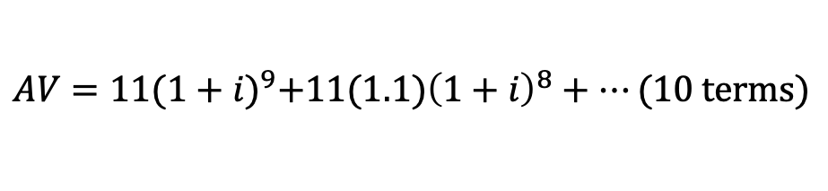
$$Unknown Interest Rates$$
$$i=aeir$$
$$11$$
$$11(1.1)$$
$$⋯$$
$${11(1.1)}^{9}$$
$$⋯$$
$$years$$
$$AV=220.8$$
Step 1: VEP at the Valuation Date
$$AV=11{(1+i)}^{9}+11(1.1){\left(1+i\right)}^{8}+⋯(10 terms)$$

Slide 26
$$Unknown Interest Rates$$
$$i=aeir$$
$$11$$
$$11(1.1)$$
$$⋯$$
$${11(1.1)}^{9}$$
$$⋯$$
$$years$$
$$AV=220.8$$
Step 1: VEP at the Valuation Date
$$AV=11{(1+i)}^{9}+11(1.1){\left(1+i\right)}^{8}+⋯(10 terms)$$
Step 2: Factor out the First Term

Slide 27

$$Unknown Interest Rates$$
$$i=aeir$$
$$11$$
$$11(1.1)$$
$$⋯$$
$${11(1.1)}^{9}$$
$$⋯$$
$$years$$
$$AV=220.8$$
Step 1: VEP at the Valuation Date
$$AV=11{(1+i)}^{9}+11(1.1){\left(1+i\right)}^{8}+⋯(10 terms)$$
Step 2: Factor out the First Term
$$220.8=11{(1+i)}^{9}∙\left(1+\frac{1.1}{1+i}+⋯(10 terms)\right)$$

Slide 28

$$Unknown Interest Rates$$
$$i=aeir$$
$$11$$
$$11(1.1)$$
$$⋯$$
$${11(1.1)}^{9}$$
$$⋯$$
$$years$$
$$AV=220.8$$
Step 1: VEP at the Valuation Date
$$AV=11{(1+i)}^{9}+11(1.1){\left(1+i\right)}^{8}+⋯(10 terms)$$
Step 2: Factor out the First Term
$$220.8=11{(1+i)}^{9}∙\left(1+\frac{1.1}{1+i}+⋯(10 terms)\right)$$

Slide 29
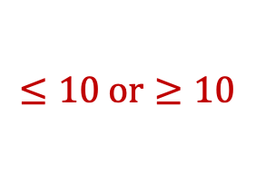
$$Unknown Interest Rates$$
$$i=aeir$$
$$11$$
$$11(1.1)$$
$$⋯$$
$${11(1.1)}^{9}$$
$$⋯$$
$$years$$
$$AV=220.8$$
Step 1: VEP at the Valuation Date
$$AV=11{(1+i)}^{9}+11(1.1){\left(1+i\right)}^{8}+⋯(10 terms)$$
Step 2: Factor out the First Term
$$220.8=11{(1+i)}^{9}∙\left(1+\frac{1.1}{1+i}+⋯(10 terms)\right)$$
$$≤10 or≥10$$

Slide 30
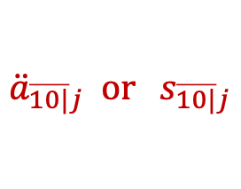
$$Unknown Interest Rates$$
$$i=aeir$$
$$11$$
$$11(1.1)$$
$$⋯$$
$${11(1.1)}^{9}$$
$$⋯$$
$$years$$
$$AV=220.8$$
Step 1: VEP at the Valuation Date
$$AV=11{(1+i)}^{9}+11(1.1){\left(1+i\right)}^{8}+⋯(10 terms)$$
Step 2: Factor out the First Term
$$220.8=11{(1+i)}^{9}∙\left(1+\frac{1.1}{1+i}+⋯(10 terms)\right)$$
$$≤10 or≥10$$
$${\ddot{a}}_{\overline{10|}j} or s_{\overline{10|}j}$$

Slide 31

$$Unknown Interest Rates$$
$$i=aeir$$
$$11$$
$$11(1.1)$$
$$⋯$$
$${11(1.1)}^{9}$$
$$⋯$$
$$years$$
$$AV=220.8$$
Step 1: VEP at the Valuation Date
$$AV=11{(1+i)}^{9}+11(1.1){\left(1+i\right)}^{8}+⋯(10 terms)$$
Step 2: Factor out the First Term
$$220.8=11{(1+i)}^{9}∙\left(1+\frac{1.1}{1+i}+⋯(10 terms)\right)$$
$$≤10 or≥10$$
$${\ddot{a}}_{\overline{10|}j} or s_{\overline{10|}j}$$

Slide 32
$$Unknown Interest Rates$$
$$i=aeir$$
$$11$$
$$11(1.1)$$
$$⋯$$
$${11(1.1)}^{9}$$
$$⋯$$
$$years$$
$$AV=220.8$$
Step 1: VEP at the Valuation Date
$$AV=11{(1+i)}^{9}+11(1.1){\left(1+i\right)}^{8}+⋯(10 terms)$$
Step 2: Factor out the First Term
$$220.8=11{(1+i)}^{9}∙\left(1+\frac{1.1}{1+i}+⋯(10 terms)\right)$$
$$≤10 or≥10$$
$${\ddot{a}}_{\overline{10|}j} or s_{\overline{10|}j}$$

Slide 33


$$Unknown Interest Rates$$
$$i=aeir$$
$$11$$
$$11(1.1)$$
$$⋯$$
$${11(1.1)}^{9}$$
$$⋯$$
$$years$$
$$AV=220.8$$
Step 1: VEP at the Valuation Date
$$AV=11{(1.1)}^{9}+11{\left(1.1\right)}^{8}(1+i)+⋯(10 terms)$$
Step 2: Factor out the First Term
$$220.8=11{(1.1)}^{9}∙\left(1+\frac{1+i}{1.1}+⋯(10 terms)\right)$$
Step 3: Recognize the Remaining Factor
$$220.8=11{(1.1)}^{9}∙{\ddot{a}}_{\overline{10|}j}$$
$$⇒j=0.03773⋯=\frac{1.1}{1+i}−1$$
$$⇒i=0.06$$

